Slide 1
Distributed Systems
Knowledge in Related Areas

Slide 2
Three areas
  Software engineering
  Operating systems
  Networks

Slide 3
Software Engineering Basics

Slide 4
Procedural vs. Object-oriented Programming
Procedural languages
  C language,
  use procedures (functions) to break down the complexity of the tasks that an application entails.
Object-oriented languages
  Java, C++,
  use objects to encapsulate the details. Each object simulates an object in real life, carrying state data as well as behaviors. State data are represented as instance data. Behaviors are represented as methods.

Slide 5
Software Life Cycle
Analysis and specification of the task
(problem definition)
Design of the software
(object and algorithm design)
Implementation (coding)
Maintenance and evolution of the system
Obsolescence

Slide 6
Operating Systems Basics

Slide 7
Operating systems basics
A process consists of an executing program, its current values, state information, and the resources used by the operating system to manage its execution.
A program is an artifact constructed by a software developer; a process is a dynamic entity which exists only when a program is run.

Slide 8
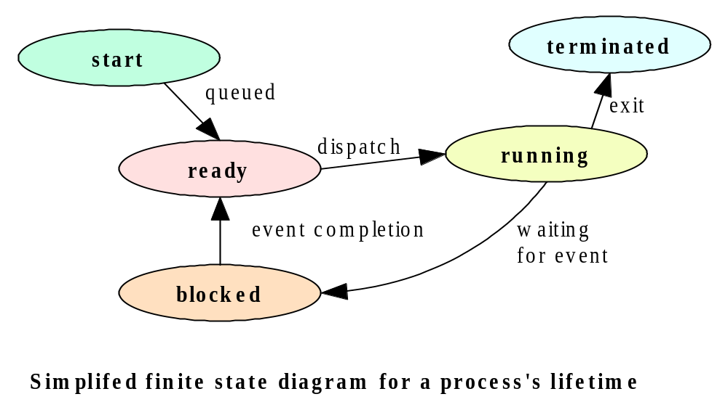
Process State Transition Diagram

Slide 9
Java processes
There are three types of Java program: applications, applets, and servlets, all are written as a class.
  A Java application program has a main method, and is run as an independent(standalone) process.
  An applet does not have a main method, and is run using a browser or the appletviewer.
  A servlet does not have a main method, and is run in the context of a web server.
A Java program is compiled into bytecode, a universal object code. When run, the bytecode is interpreted by the Java Virtual Machine (JVM).

Slide 10
Three Types of Java programs
Applications
a program whose byte code can be run on any system which has a Java Virtual Machine. An application may be standalone (monolithic) or distributed (if it interacts with another process).
Applets
A program whose byte code is downloaded from a remote machine and is run in the browser’s Java Virtual Machine.
Servlets
A program whose byte code resides on a remote machine and is run at the request of an HTTP client (a browser).

Slide 11
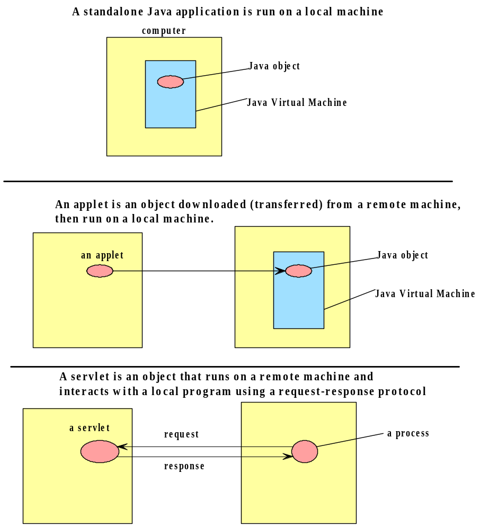
Three Types of Java programs

Slide 12
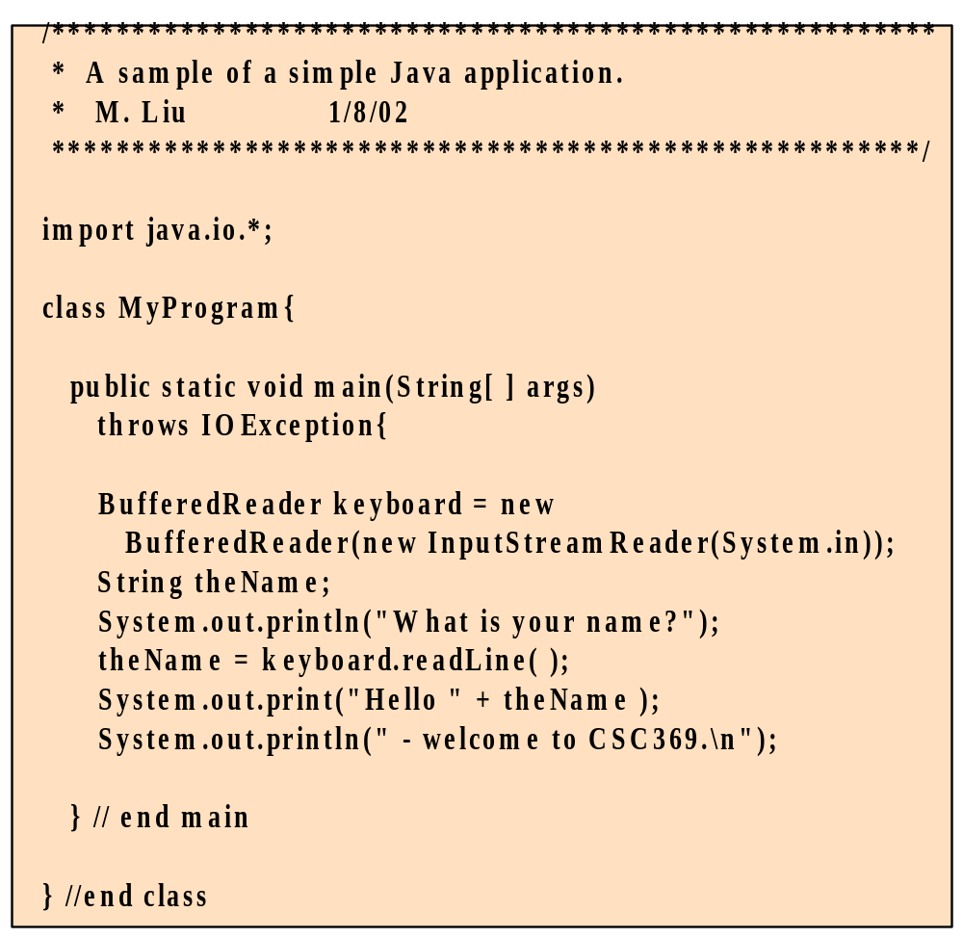
A sample stand-alone Java application

Slide 13
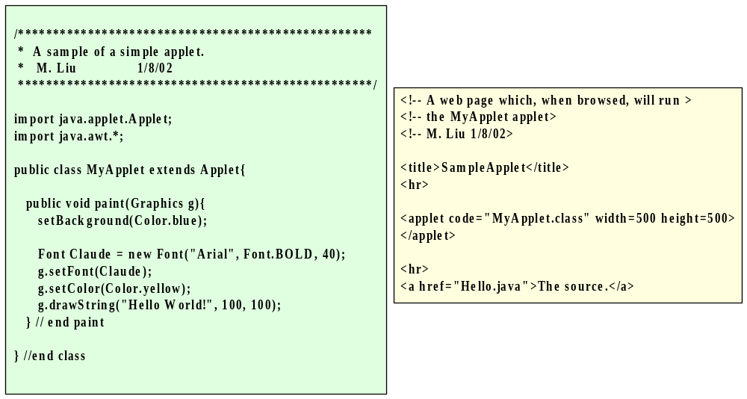
A Sample Java Applet

Slide 14
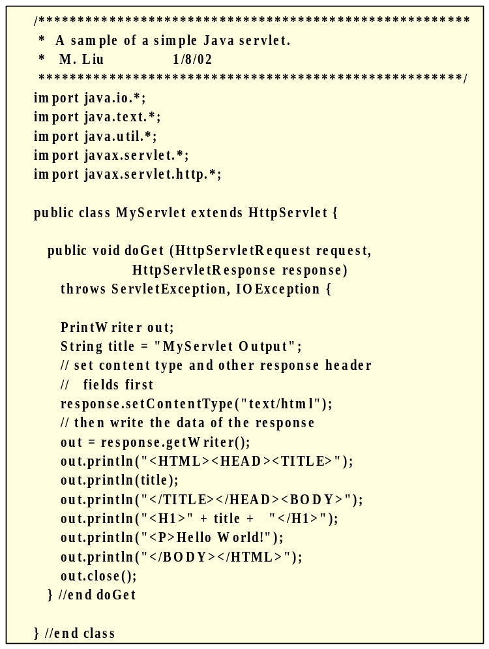
A Sample Java Servlet

Slide 15
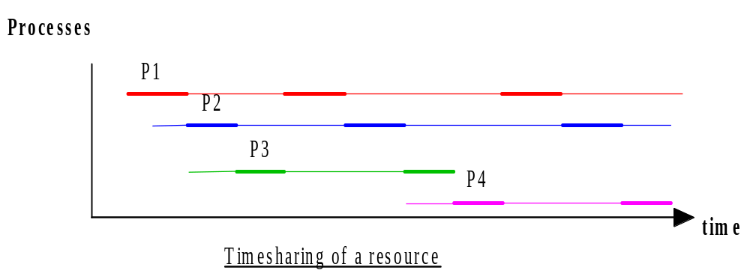
Concurrent Processing
On modern day operating systems, multiple processes appear to be executing concurrently on a machine by timesharing resources.

Slide 16
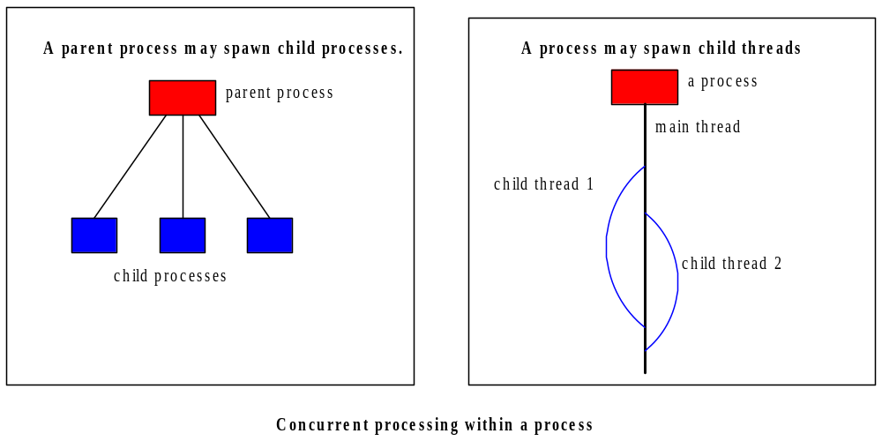
Concurrent processing within a process
It is often useful for a process to have parallel threads of execution, each of which timeshare the system resources in much the same way as concurrent processes.

Slide 17
Network Basics

Slide 18
Network standards and protocols
On public networks such as the Internet, it is necessary for a common set of rules to be specified for the exchange of data.
Such rules, called protocols, specify such matters as the formatting and semantics of data, flow control, error correction.
Software can share data over the network using network software which supports a common set of protocols.

Slide 19
Protocols
In the context of communications, a protocol is a set of rules that must be observed by the participants.
In communications involving computers, protocols must be formally defined and precisely implemented. For each protocol, there must be rules that specify the followings:
  How is the data exchanged encoded?
  How are events (sending , receiving) synchronized so that the participants can send and receive in a coordinated order?
The specification of a protocol does not dictate how the rules are to be implemented.

Slide 20
The network architecture
Network hardware transfers electronic signals,which represent a bit stream, between two devices.
Modern day network applications require an application programming interface (API) which masks the underlying complexities of data transmission.
A layered network architecture allows the functionalities needed to mask the complexities to be provided incrementally, layer by layer.
Actual implementation of the functionalities may not be clearly divided by layer.

Slide 21
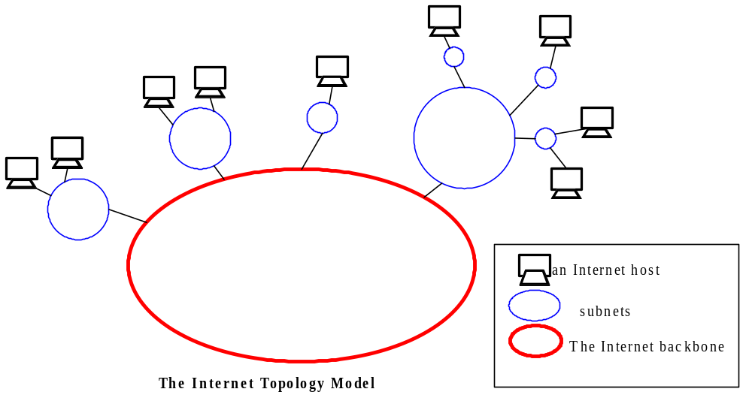
The Internet Topology

Slide 22
Protocol Layers of TCP/IP
The Internet protocol stack
  application: FTP, SMTP, HTTP
  transport: TCP, UDP
  network: IP, routing protocols
  link: PPP, Ethernet
  physical: bits “on the wire”
application
transport
network
link
physical
TCP/IP

Slide 23
Household Analogy
Letter
Kid
Family
Father
Postal office
Postman
Vehicle
TCP/IP

Slide 24
application
transport
network
link
physical
TCP/IP

Slide 25





The Application Layer
Network applications
  Email, the Web, IM, remote login, P2P, file transfer, network games, video-conference…
App-layer protocols
  SMTP, HTTP, FTP…
Example: Web (http)
application
transport
network
data link
physical
application
transport
network
data link
physical
application
transport
network
data link
physical
TCP/IP

Slide 26
application
transport
network
link
physical
TCP/IP

Slide 27
The Transport Layer
Service:
  Provide logical communication between app processes running on different hosts
Run in end systems
  Send: breaks app messages into segments, passes to network layer
  Rcv: reassembles segments into messages, passes to app layer
application
transport
network
data link
physical
network
data link
physical
network
data link
physical
network
data link
physical
logical end-end transport
network
data link
physical
network
data link
physical
application
transport
network
data link
physical
TCP/IP

Slide 28

Connection-oriented transport: TCP
Reliable, in-order, end-to-end, byte stream, flow control, congestion control
Three-way handshake, acknowledgement, sequence number
  Go-Back-N (GBN) protocol
TCP/IP

Slide 29
User Datagram Protocol: UDP
Connectionless transport
  Reduce delay
  Reduce memory space
  Small packet header
“Best effort” service, UDP segments may be:
  lost, or
  delivered out of order to application
TCP/IP

Slide 30
application
transport
network
link
physical
TCP/IP

Slide 31
The Network Layer
Transmit segment from sending to receiving end host
  Send: encapsulates segments into datagrams
  Rcv: reassembles datagrams into segment
network layer protocols in every host, router
Two functions: Routing & Forwarding
application
transport
network
data link
physical
5. Data flow begins
6. Receive data
application
transport
network
data link
physical
4. Call connected
3. Accept call
1. Initiate call
2. incoming call
TCP/IP

Slide 32
Routing/Routing Tables
z
w
x
y
A
D
B
Routing table in D
C
Destination Network Next Router Num. of hops to dest.
w A 2
y B 2
z B 7
x -- 1
…. …. ....
TCP/IP

Slide 33
Routing Algorithms
Performance requirement
  Delay, cost…
Global or decentralized information?
  All routers have complete topology, link cost info
    Link state algorithm
  Router only knows physical neighbor routers
    Distance vector algorithm
TCP/IP

Slide 34
IP: The Internet Protocol
223.1.1.1
IP addressing
  IP address: 32-bit identifier for host, router interface
    subnet part
    host part
  How does host get IP address?
    Manual configuration
    DHCP (“plug-and-play” )
Routing schemes
223.1.2.1
223.1.1.2
223.1.1.4
223.1.2.9
223.1.2.2
223.1.1.3
223.1.3.27
subnet
223.1.3.1
223.1.3.2
223.1.1.1 = 11011111 00000001 00000001 00000001
223
1
1
1
TCP/IP

Slide 35
Transport vs. Network Layer
Network
  logical communication between hosts
Transport
  logical communication between processes in hosts
  relies on, enhances, network layer services
application
application
application
P4
P3
P1
P2
P1
transport
transport
transport
network
network
network
link
link
link
physical
physical
physical
TCP/IP

Slide 36
application
transport
network
link
physical
TCP/IP

Slide 37
The Data Link Layer
“link”
Nodes: hosts & routers
Links:
  wired links
  wireless links
  LANs
Protocols: Ethernet, PPP
Service:
  framing, link access, reliable delivery, error detection & correction, flow control…
data-link layer: transferring data from
one node to adjacent node over a link

Slide 38

Multiple Access Links and Protocols
Multiple access links
  single shared communication channel
  simultaneous transmissions: interference
Multiple access protocol
  Distributed algorithm that determines how nodes share channel, i.e., determine when node can transmit
  TDMA

Slide 39
Transport vs. Data Link Layer
Data link layer
  Node-to-node (one link)
  Use MAC address
  For error-prone links (wireless)
Transport
  Host-to-host (entire route)
  Use IP address
Both:
  Reliable delivery
  flow control
  error detection
TCP/IP

Slide 40
application
transport
network
link
physical
TCP/IP

Slide 41
Physical layer
To move the individual bits within a dataframe from the link layer, from one node to anther
To convey the 0/1 bit stream into
  electrical impulse
  light
  radio
  ..
TCP/IP

Slide 42
Encapsulation
A message transmission procedure
source
destination
M
application
transport
network
link
physical
application
transport
network
link
physical
M
message
H
M
H
t
M
segment
t
H
H
H
H
M
datagram
n
t
M
n
t
H
H
H
H
H
H
M
frame
l
n
t
M
l
n
t
Physical channel
TCP/IP

Slide 43
Household Analogy
Letter = message
Kid = process
Family = end host
Father = transport layer protocol
  Reliable delivery
Postal office = network layer
  Find routes
Postman = Data link layer
Vehicle = channel
TCP/IP

Slide 44

An Example: Socket Programming with TCP
create socket,
port=x, for
incoming request:
welcomeSocket = ServerSocket()
TCP
connection setup
create socket,
connect to severid, port=x
wait for incoming
connection request
connectionSocket = welcomeSocket.accept()
clientSocket = Socket()
send request using
clientSocket
read request from
connectionSocket
write reply to
connectionSocket
read reply from
clientSocket
close
connectionSocket
close
clientSocket

Slide 45
import java.io.*;
import java.net.*;
class TCPClient {
public static void main(String argv[]) throws Exception
{
String sentence;
String modifiedSentence;
.... //get input stream from user
Socket clientSocket = new Socket(“servername", 6789);
// Create client socket, connect to server
.... //Connect stream to socket for transmission
outToServer.writeBytes(sentence + '\n'); // Send line to server
modifiedSentence = inFromServer.readLine(); // Read line from server
…. // output to user
clientSocket.close(); //Close connection
}
Java client

Slide 46
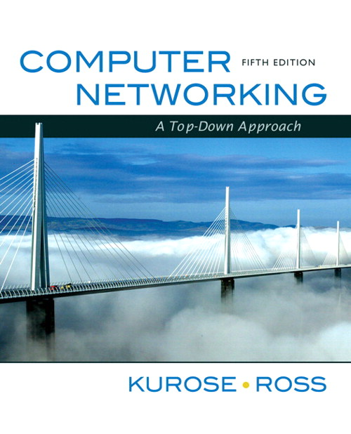
Summary
Computer networks
Internet
TCP/IP
Application layer
Transport layer
Network layer
Data link layer
Physical layer
Reference book: Computer Networking: A Top-Down Approach, 5th Edition, By James F. Kurose, Keith W. Ross
TCP/IP

Slide 47
Questions
What is OSI model layers (7 layers)?

